Slide 1
HKUST CSE FYP 2020-2021 CECI1: SumNews (Automatic News summarization)
Presenters:
Chau Shun Wai (Klaus)
Leung Hang Kam (Jimmy)
Leung Hin Fung (Martin)
To Ming San (Anson)
Advisor: Dr Cecia Chan

Slide 2

Background
We are living in fast-paced modern society!!
Too many info vs Limited concentration
Too few tools for efficient news reading
Notes:
Anson according to a block, users are receiving 34 gigabytes of information a day

Slide 3
Background
Our proposed solution:
A full-fledged application providing summarized news material
Notes:
Anson

Slide 4
Background
Choice of Platform: Web application
Favors reading on everywhere as one wishes
Notes:
Anson

Slide 5
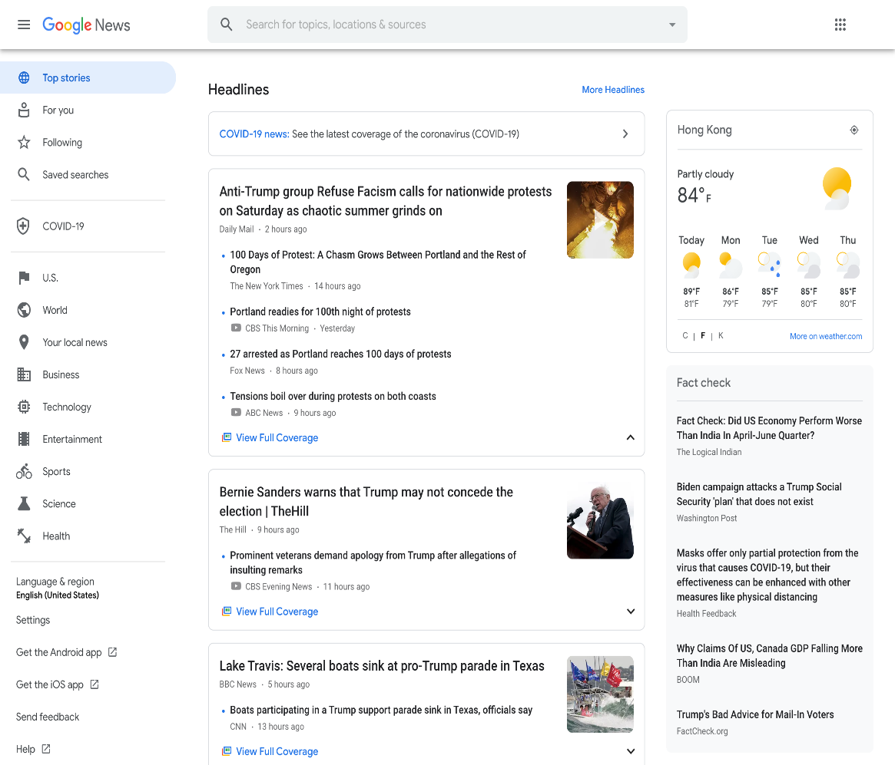
Existing Applications
Google News Features:
Group the same topic from multiple sources
A fact-check section offered
Share and save news articles
Notes:
Anson

Slide 6
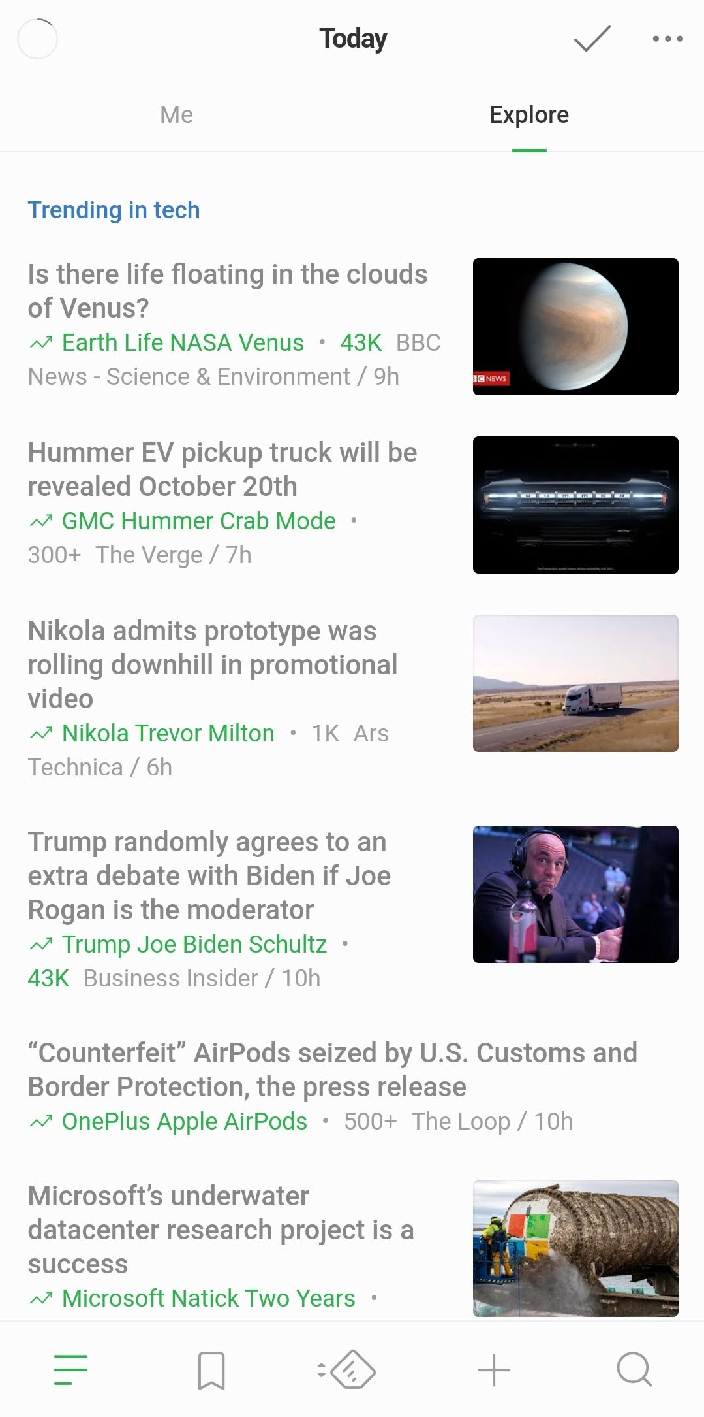
Existing Applications
Feedly Features:
Uses RSS feeds for news fetching
A well-designed interface
Article sharing and bookmarking on the readers’ side.
Equips with an artificial intelligent assistant filtering duplicated information and prioritizing articles according to users’ preferences

Slide 7

Existing Applications
Stand News (local newspaper)
Features
A good user experience, in a way that with the clean user interface
Drawbacks
Not a neutral news-reading application
Not offering a search function

Slide 8
Project Overview
Purpose | Product
Gather news from various sites | Web scraper engine
Group news | Supervised classification model
Summarize news & find unique content | Summarization algorithm
Build a friendly reading platform | Frontend web platform
Store & retrieve summarized news | Database with API support
Notes:
(Jimmy) Thanks Anson. \\
In order to refine upon the existing applications,
we realize that ours should be able to perform certain task. \\
First we need our app to be able to
gather news from various sources. \\
For that we have a corresponding scraping engine. \\
Then we need the ability
to group and summarize on various article pieces. \\
For these two, we have made available some machine learning routines. \\
We also want our app to deliver nice user experience. \\
For this we have made a nice-looking web frontend platform. \\
Finally we want the app to be able to
store and retrieve summarized news on demand. \\
This is where our database and API come into play. \\

Slide 9
News Data Flow
Database
Web Scraping
Articles Grouping
News Group Summarization
Related News Computation
Notes:
(Jimmy) The flow chart in the slide
should now give you a more concrete view
on how the data is flowing in the application. \\
In the first phase of web scraping,
news articles data is obtained via web. \\
Then the data, after preprocessing,
is passed to the classification algorithm,
so that some groups of similar articles can be formed. \\
These news groups are then passed to
another algorithm for further summarizing. \\
Finally we perform computation on related news for the news groups. \\
Of course such data flow cannot be done without the database. \\

Slide 10
Web Scrapper
Foreign News Sources
Local News Sources
BBC
SCMP
Reuters
Standard
Fox
Guardian
HKFP
USA Today
RTHK
NBC
Notes:
(Jimmy) Now let's take a look at the web scraper. \\
For configuring our application,
we pick 10 news sources, 6 from foreign media and 4 from local. \\
It includes BBC, reuters, SCMP, HKFP, and others as shown in the slides,
in which most of them are widely accepted
as honest and objective news producers. \\

Slide 11
Web Scrapper
There are three steps.
Obtain articles’ urls that are already in database.
Scrape articles’ urls from each news site.
Scrape the useful content from each article url.
Notes:
(Jimmy) And for the actual routine,
we can conceptualize it as a 3-step process. \\
We first obtain articles' urls that are already in database,
then we scrape urls from the news sites that we picked,
finally we scrape out the useful content from each article url. \\

Slide 12
Web Scrapper
Step 1 -- Obtain articles’ urls that are already in database.
(Why?)
Prevent storing or analyzing duplicated news pieces.
Notes:
(Jimmy) From what we obtain in step 1,
we can perform filtering on url level
to prevent duplicated storage or computation in subsequent steps. \\
That's why this step is crucial in the routine. \\

Slide 13
Web Scrapper
Step 1 -- Obtain articles’ urls that are already in database.
(How?)
By fetching on API end-points!! More details on API design later.
Notes:
(Jimmy) And the way we accomplish the task on step 1, \\
is simply by issuing an appropriate GET request to the database. \\
Technical details are largely simplified by our restful API,
which would be covered in more details later. \\

Slide 14
Web Scrapper
Step 2 -- Scrape articles’ urls from each news site.
(Why?)
News from certain category are to be excluded. Example: Album series; Opinion pieces
Most likely the url would contain some information about its own category, we then can perform regex filtering to give appropriate urls to Step 3.
Notes:
(Jimmy) The next step is about obtaining articles’ urls from each news site. \\
You may wonder why the scraping on url and article content
are put into separate steps. \\
It is because we don't really want our application
to be dealing with every kind of articles in any site. \\
The odds are we could be obtaining image collections,
or some opinion pieces written with subjective bias. \\
Luckily most of them would reveal themselves in their urls. \\
We then can customize regular expressions for each site,
so that in the subsequent steps,
the program would be aware of it,
and hence less likely be polluted by these kind of data. \\

Slide 15
Web Scrapper
Step 2 -- Scrape articles’ urls from each news site.
(How?)
Three approaches
Via computation in newspaper3k
Via html parsing by bs4
Via “real” scraping by selenium
Pre-built libs are faster, but not very reliable. We then need some slower “default” approaches.
Notes:
(Jimmy) Basically step 2 is done with several approaches. \\
By manual testing, we find the 3rd party library newspaper3k
is quite efficient for our purpose,
and give quite complete results on some foreign sites. \\
In this case we use newspaper3k for those sites. \\
For some others that does not perform well with newspaper3k,
we use either beautifulsoup or selenium library
for parsing certain html section on the main page of that site,
so that we can obtain what we want. \\
Here completeness or accuracy of data is our utmost concern,
so even slower approaches like the one with selenium
are still implemented and used in the routine. \\

Slide 16
Web Scrapper
Step 3 -- Scrape the useful content from each article url.
(Why?)
Give input to the next step of the app data flow
Notes:
(Jimmy) With data from step 2 ready,
we can then proceed to scrape the article content. \\
In ths step, we are gonna provide the article's texts, date, source,
and some other information to the database for evaluation in next phase. \\

Slide 17
Web Scrapper
Step 3 -- Scrape the useful content from each article url.
(How?)
Employ newspaper3k for building article object from url. Often it comes with noise, like advertisement messages.
Further employ bs4 on html to give appropriate fix.
A list of json is then posted to the Database.
Notes:
(Jimmy) Again, we start by observing the article object output
from the pre-built newspaper3k library. \\
The odds are some random advertisement texts or images
could be mixed with the real meaningful messages,
then in this case we employ the beautifulsoup library
for introducing fix on data entries via html parsing. \\
After that, the data as a list of json are posted to the database. \\

Slide 18
Articles Grouping
Overall flow in each iteration
Fetch news group & ungrouped articles. Perform sampling.
Compare ungrouped articles to existing news group.
For the remaining, perform pairwise comparison.
Post the produced news-group list to Database.
For articles remain ungrouped, let them wait in Database for next round of computation.
Notes:
(Jimmy) At this point we are done with the 3-step scraping routine. \\
Now let's talk about articles grouping. \\
Overall in each iteration, we first obtain from database
the pre-computed news group and the list of ungrouped articles. \\
Such list of could be quite long
and so we employ random sampling
to determine what we would be dealing with in this round. \\
Then we compare each ungrouped articles to each existing news group
to see if the articles can be grouped with the current one. \\
For the remaining, we further perform pairwise comparison
with an aim to form some groups of two. \\
After that we simply post our computed result to the database. \\
Despite of all these efforts,
the odds are, there are always some articles
that cannot be grouped in one round. \\
We would simply let them untouched and wait in Database,
so that they could go through the whole process
again in later iteration. \\

Slide 19
Articles Grouping
Idea behind
Supervised learning
Pre-grouped articles are stored in Database
Binary Classification Model
Check if any two articles should be grouped together
Group-To-Element Classification
Check if a given article belongs to a given group
Notes:
(Jimmy) From the above sketch,
we can further discuss some key elements.
The first one is that,
our algorithm is actually a form of supervised learning.
It implies that it is taking pre-grouped news
at iteration zeroth for its subsequent training.
The next element is that, in order to make it work,
we have to established some classification models,
for both element-to-element and group-to-element comparisons.
We shall now pass the time to Martin to discuss
the element-to-element, aka binary, classification model.

Slide 20
Articles Grouping – Binary Classification Model
Step 1: Text pre-processing
Article 1
Cleaned
Article 1
Article 2
Cleaned
Article 2
Remove stop words
Replace “COVID” / “COVID-19” with “coronavirus”
Notes:
(Martin) Before using the model, we need to do some preprocessing on the title and body paragraphs of the two articles. This includes removing stop words, and all acronyms of COVID-19 is replaced with the word “coronavirus”. This can help boost the performance of the model

Slide 21
Articles Grouping – Binary Classification Model
Step 2: Convert the title of each article to vector using word2vec model, and calculate their cosine similarity
Title 1
Title 2
Title 1 Vector
Cleaned
Article 1
Cleaned
Article 2
Feature 1:
Cosine similarity of the title vectors
Title 2 Vector
Notes:
(Martin) Next, the title of the two articles will be turned into two vectors with the aid of spacy word 2 vec model. Then the cosine similarity of the vectors will be calculated to form the first feature.

Slide 22
Articles Grouping – Binary Classification Model
Step 3: Convert the body text of each article to vector using Bag of Words (BOW) model, and calculate their cosine similarity
Cleaned
Article 1
Cleaned
Article 2
Article 1 BoW Vector
Article 2 BoW Vector
Feature 2:
Cosine similarity of the BoW vectors
Notes:
(Martin) Thirdly, the body of the two articles will be turned into two vectors using bag of words model. Then the cosine similarity of the two vectors will be calculated to form the second feature.

Slide 23
Articles Grouping – Binary Classification Model
Step 4: Feed the 2 features into the model
Feature 1:
Cosine similarity of the title vectors
Neural Network Model
Output:
0 – Different Group
1 – Same Group
Feature 2:
Cosine similarity of the BoW vectors
F1-score = 0.846
Notes:
(Martin) We are now ready to feed the two features into the neural network model that has a F1 score of 0.846. We trained the model using a training set that contained 9 thousand pairs of articles. Then the output of the model, which is either 0 or 1, will tell us whether the two articles should be grouped together or not.

Slide 24
Articles Grouping – Group-To-Element Classification
Loop and report NO whenever
#(unmatched pair) > len(group) / 2.
If no such case happens, report YES eventually.
Small database implies higher chance for mismatching with incoming articles from scraping step.
Counting for the opposite presumably helps reduce the cost of calculation by half.
Notes:
(Jimmy) Thanks Martin. As Martin has mentioned,
we have a working algorithm for element-to-element comparison. \\
Now on top of that, we could easily build up
the group-to-element routine with simple linear scan. \\
We loop through the given newsgroup
and make comparison for each of its element to the ungrouped target. \\
If you are patient enough, you might notice that
we are evaluating and reporting the answer in the opposite unmatched direction. \\
This is because our database currently is relatively small. \\
It then implies that we are more likely
to receive an NO anwser than having an YES for arbitrary inputs. \\
Hence counting for unmatched pairs
optimally could cut the run-cost by half,
hence give us some efficiency gain on the algorithm. \\

Slide 25
Summarization
Extract 3 most representational sentences from the news articles to form the summary
Algorithm from the paper:
An unsupervised method for extractive multi-document summarization based on centroid approach and sentence embeddings
Notes:
(Martin) Now, we are going to do multi-document summarization on each of the news groups by extracting the three sentences that are most representational of the news, so as to give the readers a short yet concise outline of the news
We are implementing the algorithm from the paper, and I will walk you through the important steps of the algorithm. If you look for more details, please refer to our final report.

Slide 26
Summarization
Step 1: Convert all sentences into 512 dimensional vectors
Sentence 1
Sentence 2
Sentence 3
Sentence 4
Sentence 5
Sentence 1
Sentence 2
Document 1
Sentence 3
Sentence 4
Sentence 5
Document 2
Notes:
(Martin) The first step is to convert all sentences into 512 dimensional vectors with the help of sentence embeddings.
For simplicity, I will only use two articles and 2d vector space for illustration, but the algorithm actually works for more articles and in higher dimensional space.
As we have 10 sentences here altogether, there will be 10 vectors generated in this step, which is shown on the right.

Slide 27
Summarization
Step 2: Compute the mean vector
Notes:
(Martin) Next, we are going to compute the mean vector for the 10 vectors. The mean vector is colored green in the diagram.

Slide 28
Summarization
Step 3: Rank the sentences according to the following criteria
How close is the sentence to the main idea of the news
How unique is the sentence
How front is the position of the sentence in the article
Notes:
(Martin) In step 3, we are going to rank the sentences according to three criteria

Slide 29
Summarization
Step 3 (i): Rating how close is the sentence to the main idea of the news ⇒ Content Relevance Score
Notes:
(Martin) The first criterion is that, sentences that are closer to the main idea of the news should be ranked higher, which is measured by the content relevance score.
The mean vector in green represents the main idea.
And the vectors that are blinking faster are closer to the main idea, which will be given a higher content relevance score

Slide 30
Summarization
Step 3 (ii): Rating how unique is the sentence ⇒ Sentence Novelty Score
Notes:
(Martin) The second criterion is, sentences that are more novel should also be ranked higher, which is quantified by the sentence novelty score.
Being novel means that the vector is not close to any other vectors, [CLICK] so it is obvious that the two vectors below the x-axis would be given a high score.
Another purpose of this score is to [CLICK] to capture the sentence that are the closest to the mean vector in a cluster of vectors that are close to each other.
For example, the blinking vectors are close to each other, which means that they should contain similar content, however, the light blue vector will be given a low sentence novelty score while the red vector will be given a high sentence novelty score, since the red one is closer to the mean vector.
This will prevent the summary containing repeated messages

Slide 31
Summarization
Step 3 (iii): Rating how front is the position of the sentence in the article ⇒ Sentence Position Score
Sentence 1
Sentence 1
Sentence 2
Sentence 2
Sentence 3
Sentence 3
Sentence 4
Sentence 4
Sentence 5
Sentence 5
Document 1
Document 2
Notes:
(Martin) The last criterion is, sentences that are placed in the front of the article will be ranked higher, and the sentence position score will be used to quantify it.
As the first few sentences in news articles often contain important messages, we want to give them a higher chance to be included in the summary, so that the summary will contain some important information.

Slide 32
Summarization
A linear combination of the three scores will be the final score for each sentence
Final Score = 0.6 * Content Relevance Score
+ 0.2 * Sentence Novelty Score
+ 0.2 * Sentence Position Score
Notes:
(Martin) Finally, a linear combination of the three scores will be calculated to be the final score for each sentence.
The three sentences which have the highest final score among all sentences will be extracted to form the summary.

Slide 33
Finding Unique Sentences From Each Article
Extract 2 most unique sentences from each article
Notes:
(Martin) Next, in order to aid the readers to have a more comprehensive view on the news, we are going to extract 2 most unique sentences from each article whose semantic meaning are not covered in other articles.

Slide 34
Finding Unique Sentences From Each Article
Calculate the cosine similarity of the sentences in each article with all other sentences in other articles
Sentence 1
Sentence 1
Sentence 2
Sentence 2
Sentence 3
Sentence 3
Sentence 4
Sentence 4
Sentence 5
Sentence 5
Document 1
Document 2
Notes:
(Martin) To do so, the cosine similarity of the sentences in each article will be calculated against all sentences in other articles.
For example, to find the unique content from document 1, each sentence in document 1 will be compared against all sentences in document 2, and also with document 3 4 up to document n if they exist

Slide 35
Finding Unique Sentences From Each Article
For each sentence, keep the maximum cosine similarity only
Max. Cos. Sim
0.8
Sentence 1
Sentence 1
0.9
Sentence 2
Sentence 2
0.7
Sentence 3
Sentence 3
0.2
Sentence 4
Sentence 4
0.3
Sentence 5
Sentence 5
Document 1
Document 2
Notes:
(Martin) And only the maximum cosine similarity will be kept for each sentence. If the maximum cosine similarity is high, it means that there are sentence in other document expressing similar messages, and vice versa.
So here we are looking for sentences with low maximum cosine similarity.

Slide 36
Finding Unique Sentences From Each Article
2 sentences with lowest maximum cosine similarity are determined to be unique
Max. Cos. Sim
0.8
Sentence 1
Sentence 1
0.9
Sentence 2
Sentence 2
0.7
Sentence 3
Sentence 3
0.2
Sentence 4
Sentence 4
0.3
Sentence 5
Sentence 5
Document 1
Document 2
Notes:
(Martin) And the two sentences with lowest maximum cosine similarity in each article are determined to be unique.

Slide 37
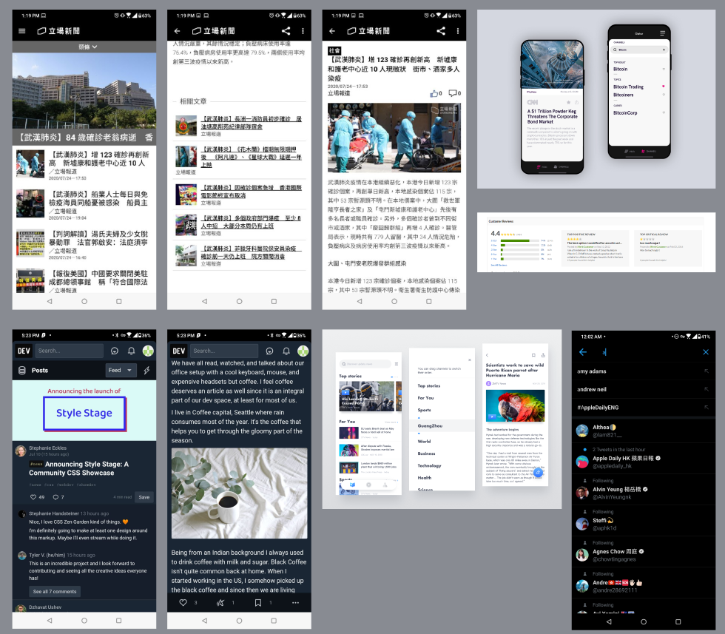
User Interface - Inspiration
Mood board:
A collection of ideas
Mood Board
Notes:
I am Klaus and I am responsible for the user interface design and front-end implementation. Before the front-end is implemented, we have looked into many other news reading applications along with some other socializing applications. We have gained a lot of motivation and inspiration from the other apps, and the majority came from two applications.
This slide is showing part of the mood board before started designing our application. In short, a mood board is also called the inspiration board, which is a place for the collections of ideas. Basically, when we see something that might be useful to our design, then we would capture the screen and paste the screenshot into our mood board.

Slide 38

User Interface - Inspiration
Stand News
Benefit: Neatly design list of news
Home Page
Notes:
One of the applications is the Stand News mobile application. Stand News is one of the most popular news reading applications developed by a local media company. The Stand News mobile application is neatly designed and is served as a great example of minimalism for us to refer to. The interface consists of the least components a user needs to read the pieces of news they want while showing the related news and the headline to the users.

Slide 39
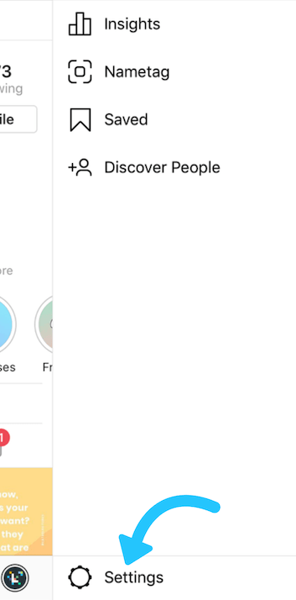


User Interface - Inspiration
Benefit: Quickly guide our users to their desired page
Instagram
The navigation bar + side drawer menu
Notes:
Another inspiration that constitutes the majority of the design is Instagram. In the design stage of our project, we are constantly looking for a solution to quickly navigate users to their desired pages. It turns out that the bottom navigation bar and side drawer menu are the solutions that we are looking for.
After looked into how we get the inspiration, let me pass it to Anson to talk about the prototype of our application.

Slide 40
User Interface - System Flow
Register / login Page
(For unauthenticated users)
Search Page
Landing Page
Top News + News List
Pages for Individual News
Page for Saved Articles
(For authenticated users)
Notes:
Now, let me briefly talk about the pages we have implemented in our prototype. In the prototype, we have roughly five pages that serve the objectives of this project: they are the landing page, register/login page, search page, news detail page, and saved article pages.

Slide 41
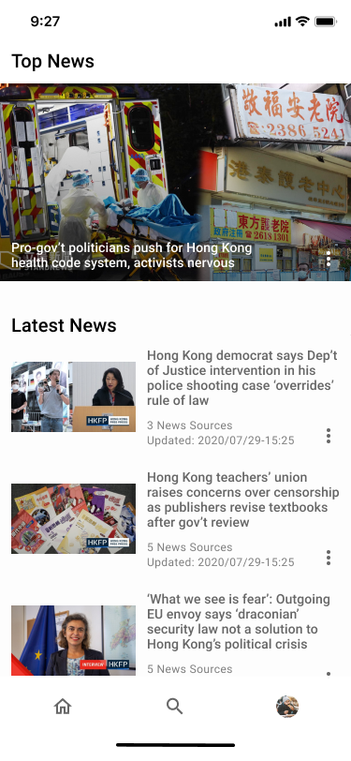
User Interface - Design
Landing Page
Carousel fitted with top news
A list of latest news (from latest to oldest)
Notes:
First, we have the landing page of the application. It is the page the user first sees when they launch our application. First, there is a carousel slider at the top of the landing page. The carousel would be fitted the most trending news that a user can click on to retrieve the top news. Below would be a list of the latest news. Again, a user can click on the news thumbnail or the news title to retrieve that specific news.

Slide 42
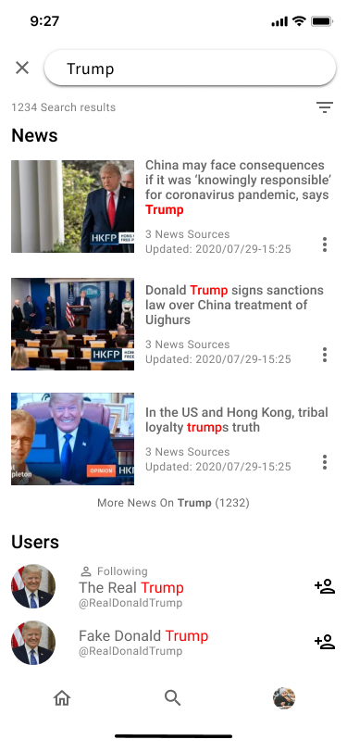
User Interface - Design
Search Page
A text field at the top of the page
User can search for related news
Notes:
Second, we have a search page. Users can simply type in the keyword that they are looking for in the text field at the top of the search page. Then, a list of the related news would be rendered on the screen. Users can then again click on the news thumbnail or the news title to retrieve that news.

Slide 43
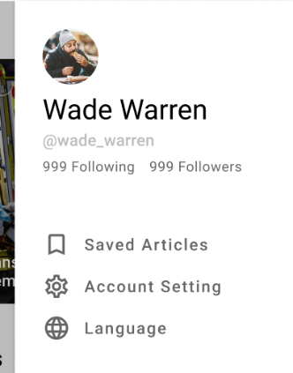
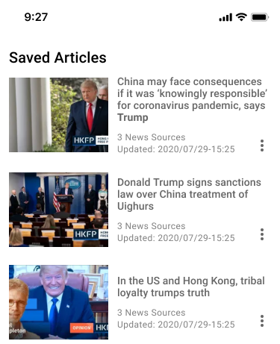
User Interface - Design
Saved articles page
Open up side drawer menu
Click on the Saved Articles tab
A page for user to retrieved saved news
Notes:
Next, is the saved articles page. Users can go to this page by first showing the side drawer menu, then click on the saved articles tab. On this page, users can see a list of news that they have saved previously by pressing the bookmark button.

Slide 44
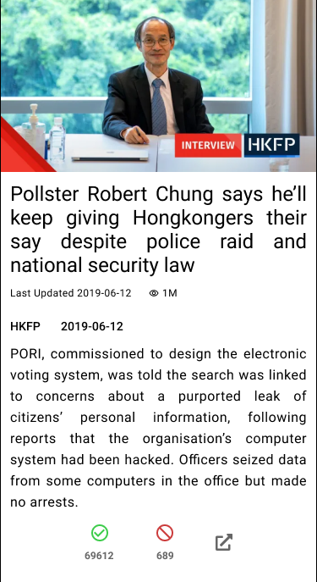
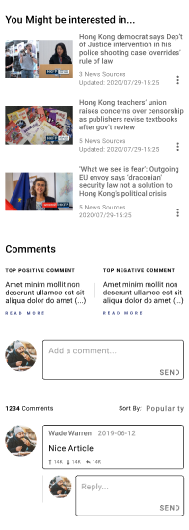
User Interface - Design
News detail page
Summarized sentences
Metadata (updated time, view count)
List of Unique contents from different articles
Notes:
Followed by the saved articles page would be the news detail page. The news detail is the heart of our application. On this page, starting from the top to the bottom of the page, we have a carousel that is fitted with images scraped from various news sources. Below are the summarized titles from multiple news sources. After that would be some metadata for that particular news detail page, such as the last updated timestamp, the view count. Then, there will be a list of unique contents from different articles. For example, in the picture at the left, we fetched an article from a press called the HKFP, then we summarized the fetched article into some sentences of unique content. After the list of unique content, there will be a list of news that the user might be interested in, which is generated by finding pieces of news that are the most similar to the currently reading news. At the bottom of the news detail page will be a comment section that allows users to leave their comments on this specific page.

Slide 45

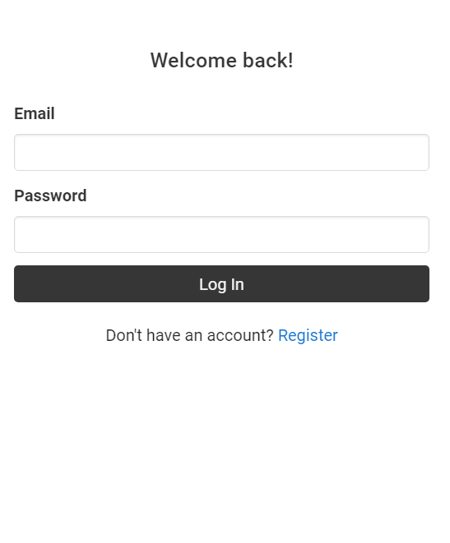
User Interface - Design
Notes:
Lastly, will be our register and login page. It is the page where we authenticate users. Users can use our application without being authenticated, but they will lose the benefit of leaving comments and saving the articles.

Slide 46

User Interface - Implementation
Vue.js
A smaller package-bundle size
A less extreme learning curves on the developers’ side and a larger flexibility
Notes:
For the implementation of the design, we mainly used only one library, which is Vue.js. We simply picked them for these few reasons: it has one of the smallest bundle sizes and one of the most shallow learning curves among all the popular front-end libraries. In addition, almost all of our members have experience in using Vue.js. Therefore, this library can help us save a lot of time learning a new framework.

Slide 47

Database
MongoDB
We have experienced with it before
Initiating schemas is easier with the Express.js framework
Built in query function for us to retrieve data
Free of charge
Notes:
Anson

Slide 48
Database
Comment
content | String
date | Date
author | Ref
upvotes | Number
downvotes | Number
User
name | String
email | String
password | String
is_logged_in | Boolean
saved_news | Ref[]
NewsGroup
articles | Ref[]
summary | String[]
photos | String[]
created_date | Date
updated_date | Date
vector | Number[]
related_groups | Ref[]
view_count | Number
Article
title | String
text | String
date_added | Date
url | String
source | String
photos_url | String[]
is_grouped | Boolean
upvotes | Number
downvotes | Number
Notes:
Anson

Slide 49

API
Handle & Retrieve data from the database
Linked to our database
Use Heroku for deployment
Notes:
Anson

Slide 50
API
“/register” and “/login” handle authentication-related post-requests from client-side.
“/news”, “/news/:news_id”, “news/deleteall” are endpoints handle certain GET and POST and DELETE requests
Notes:
Anson

Slide 51
API
“/comments”, “/comments/:news_id” take care request from client side for the comment data from users.
/:searchWords for searching news topic
Notes:
Anson

Slide 52

Testing
Black box testing for UI
See if the desired effect happens or not
Notes:
Anson

Slide 53
Testing
Automated Unit Testing for API server
Stress Test on the system
Manual inspection on Scrapper

Slide 54
Evaluation
Key focus on the questionnaire:
User Experience
Precision of Summarization
Genuine Help for the user ?
Notes:
Anson

Slide 55
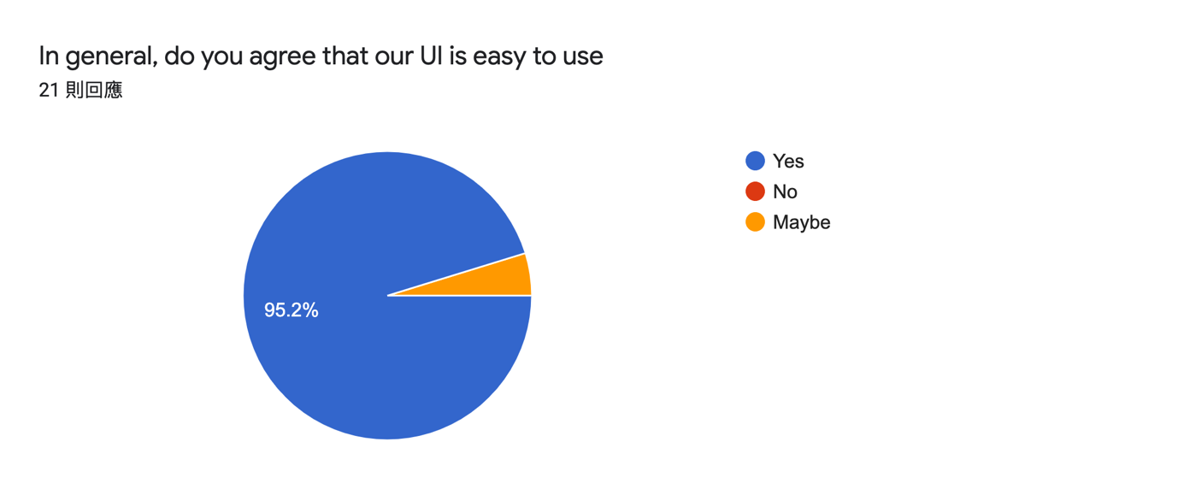
Evaluation
User Experience
Notes:
Anson

Slide 56
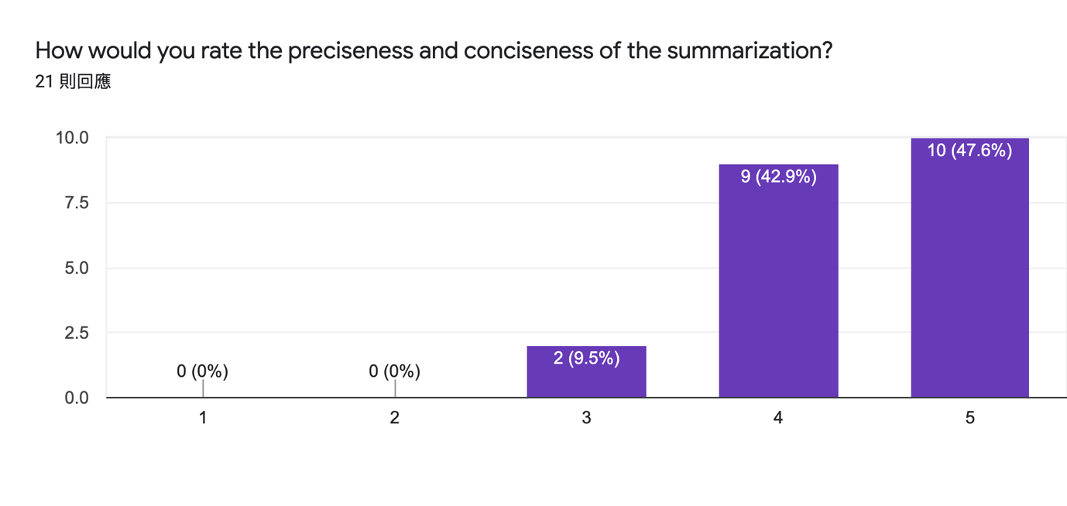
Evaluation
Precision of Summarization
Notes:
Anson

Slide 57
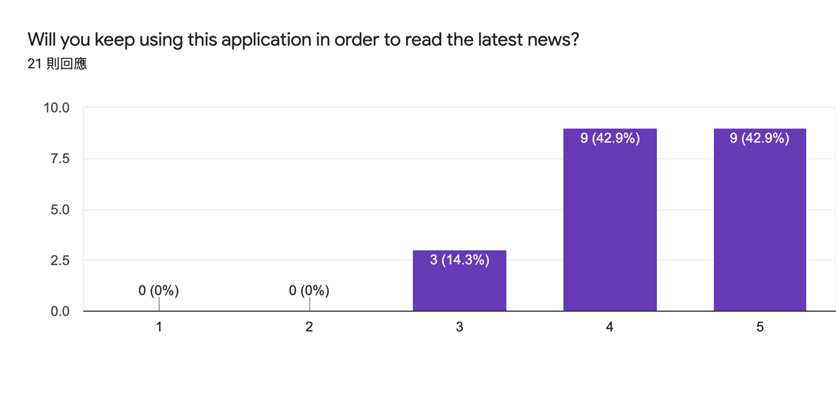
Evaluation
Genuine Help for the user ?
Notes:
Anson

Slide 58


Discussion-Future Works
Implement better search algorithm
Incorporate open-standard authorization protocol
Notes:
Anson

Slide 59


Discussion-Future Works
Refinement on web accessibility
More summarization algorithm can be tested
Notes:
Anson

Slide 60

Conclusion
Successful
Achieved the desired objectives
Users are satisfied

Slide 61
Demo Time

Slide 62

Thank you for your listening

